Slide 1


RE
Food and Fasting
Year One
RE | Year 4 | Food and Fasting | Food for Celebration | Lesson 5

Slide 2
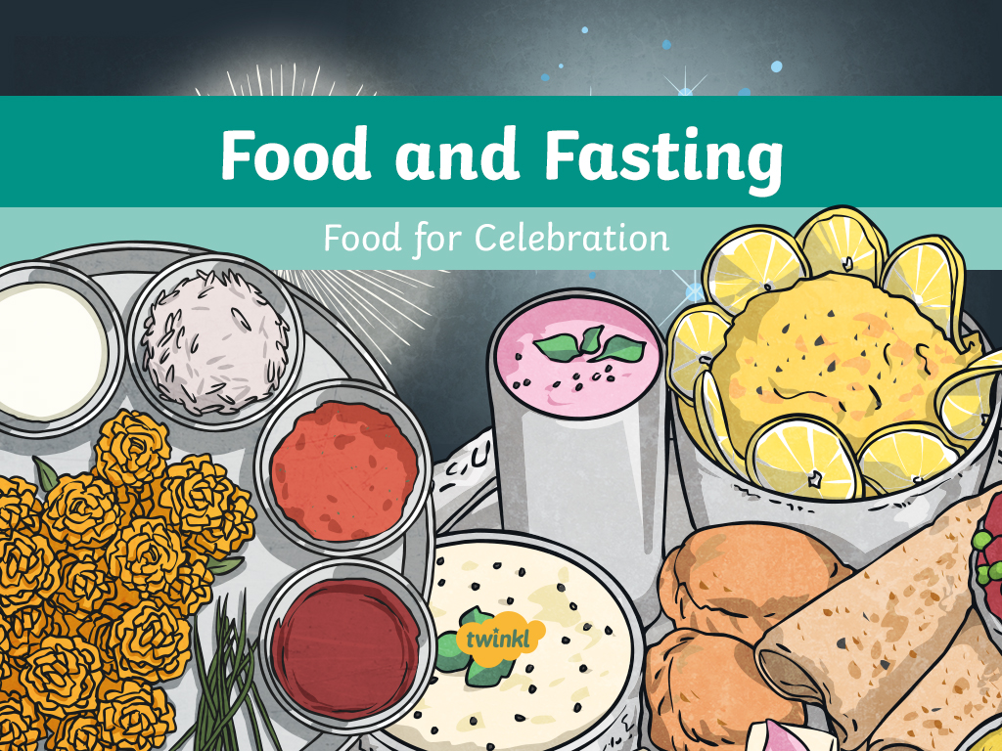

Slide 3
Aim
To understand how food is used for celebration in religion.
Success Criteria
I can share with others the foods that help me celebrate.
I can explain some key facts about Diwali.
I can name special foods for Diwali.
I can talk about the reasons why and how food is used for celebrations.
I can use key ingredients and vocabulary to create a celebratory food recipe.

Slide 4
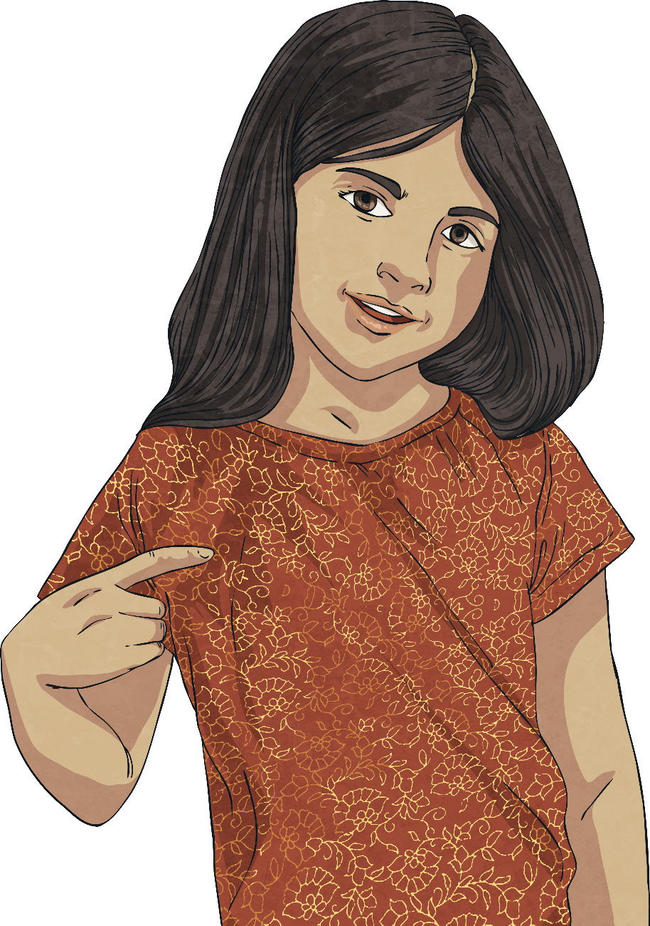
Which Food Would You Choose?
This is Amber. She is celebrating a big achievement but doesn’t know what food to have to help her celebrate. What would you recommend?

Slide 5
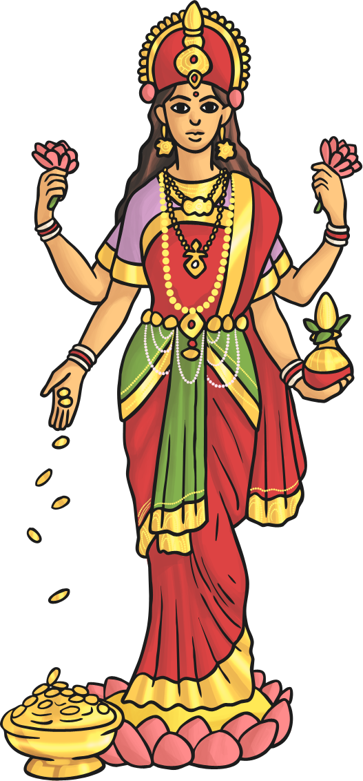
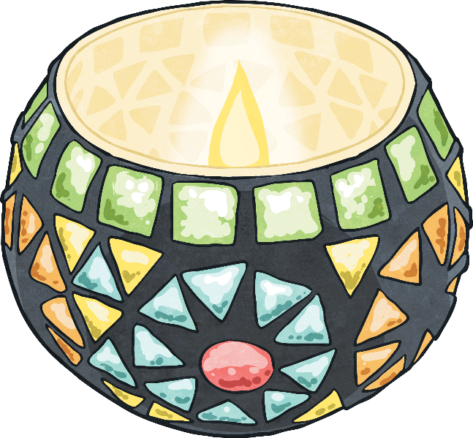
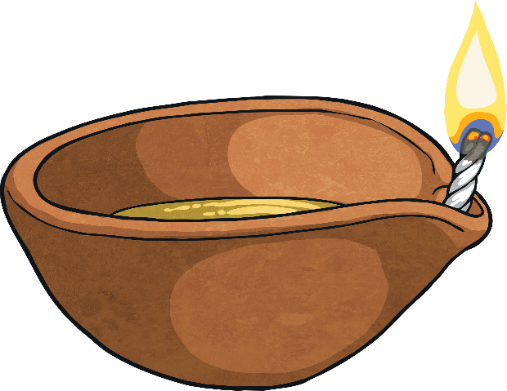
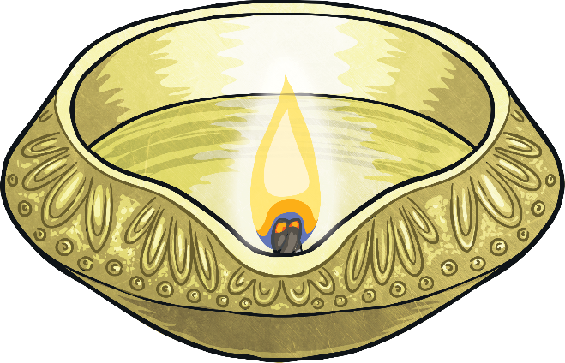
Festival of Lights
What is Diwali?
Diwali is the Hindu festival of lights. Diwali is celebrated in Hinduism in October or November each year.
During Diwali, Hindus celebrate the goddess Lakshmi, who is the goddess of wealth and prosperity.

Slide 6
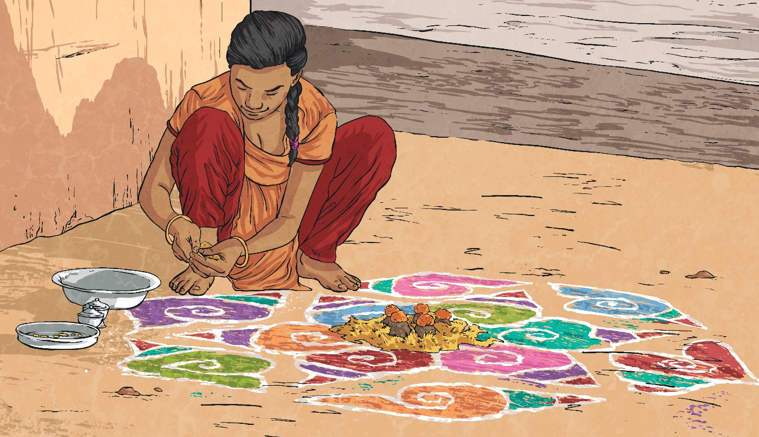
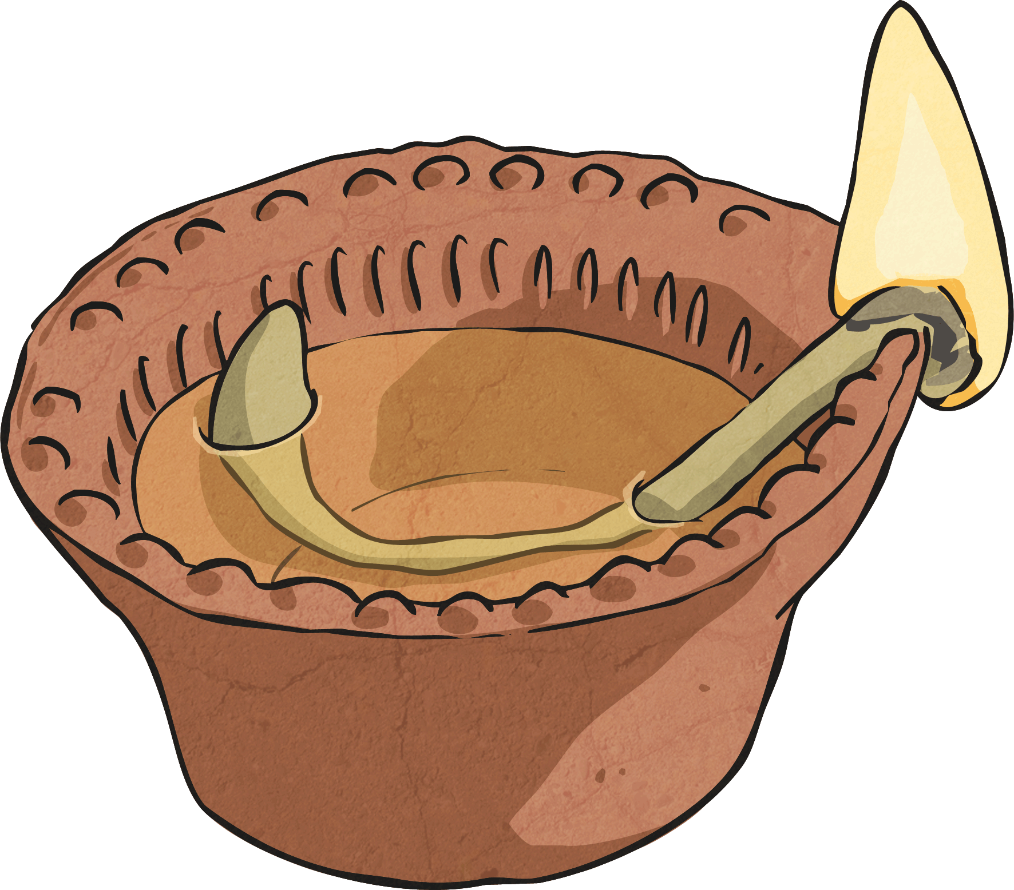
Festival of Lights
What do Hindus do during Diwali?
People create rangoli outside their doors, using coloured sand.
Diyas – special clay lamps – are lit in people’s homes to help guide the goddess Lakshmi. Houses are often decorated with lights too.

Slide 7
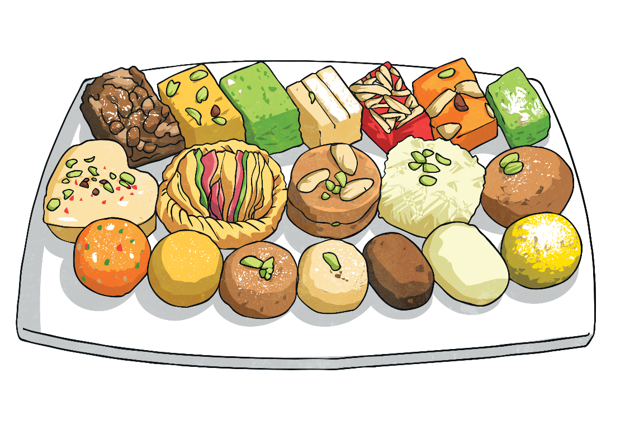
Sweet Treats
What foods do you think might be eaten at Diwali?
During Diwali, special foods are eaten. Sweets are given as gifts!
Often, Hindu women meet together to make the special sweets in their homes and then give them as gifts to celebrate the festival of lights.

Slide 8
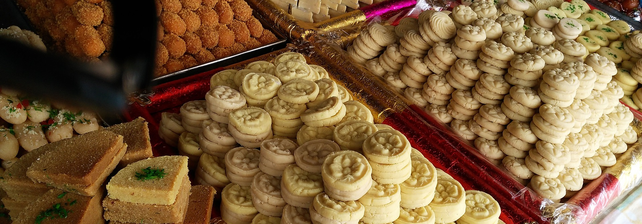
Sweet Treats
Mithai
Mithai is the name used to refer to sweets. Mithai are usually made with sugar but can also include different flours, nuts, milk and fruits as key ingredients.

Slide 9
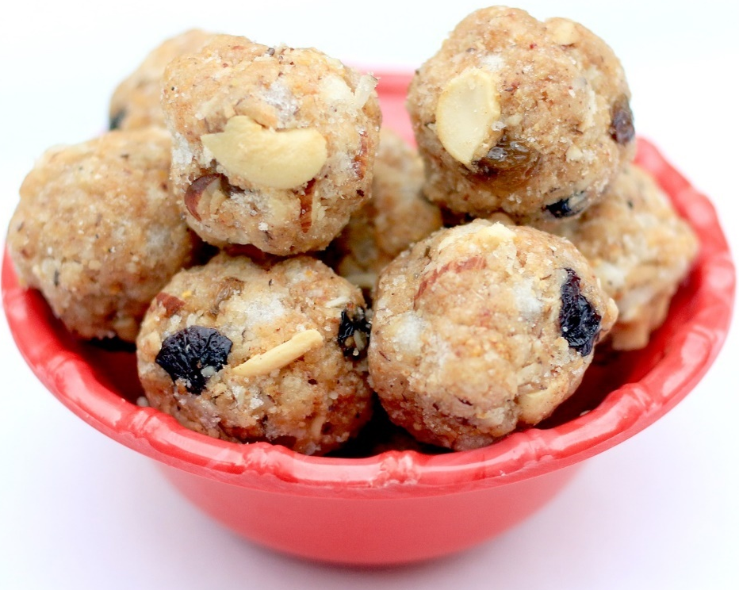
Sweet Treats
Laddoo
Shaped like balls, these sweets are made from chickpea flour, coconut or semolina. Butter and sugar is added and sometimes dried fruits or nuts.

Slide 10
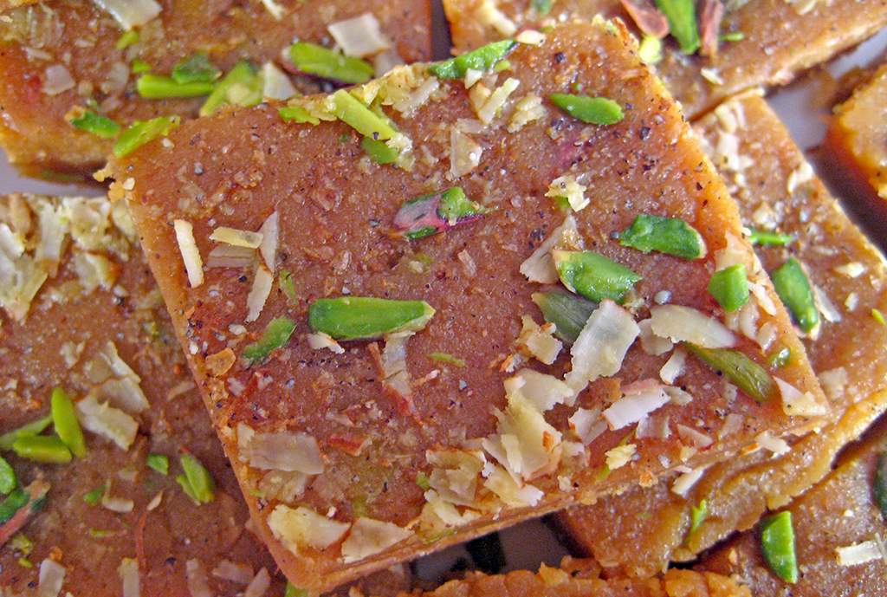
Sweet Treats
Barfi
The main ingredients of barfi are condensed milk and sugar. They might be made with flour or ground nuts and flavoured with fruits and spices.
Photo courtesy of (Soniya Goyal@flickr.com) - granted under creative commons licence – attribution

Slide 11
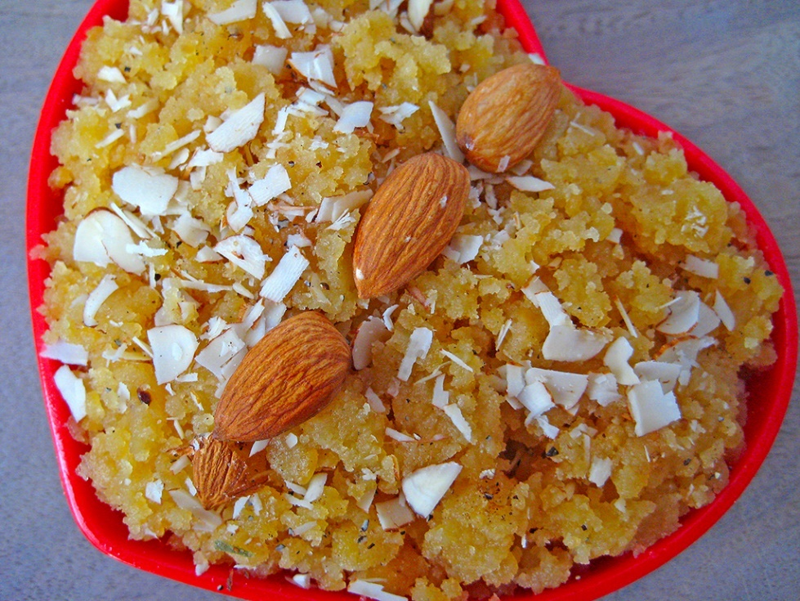
Sweet Treats
Halwa
Halwa is made from butter, milk and sugar. Nuts are often added and sometimes even carrots.
Photo courtesy of (Sameer Goyal@flickr.com) - granted under creative commons licence – attribution

Slide 12
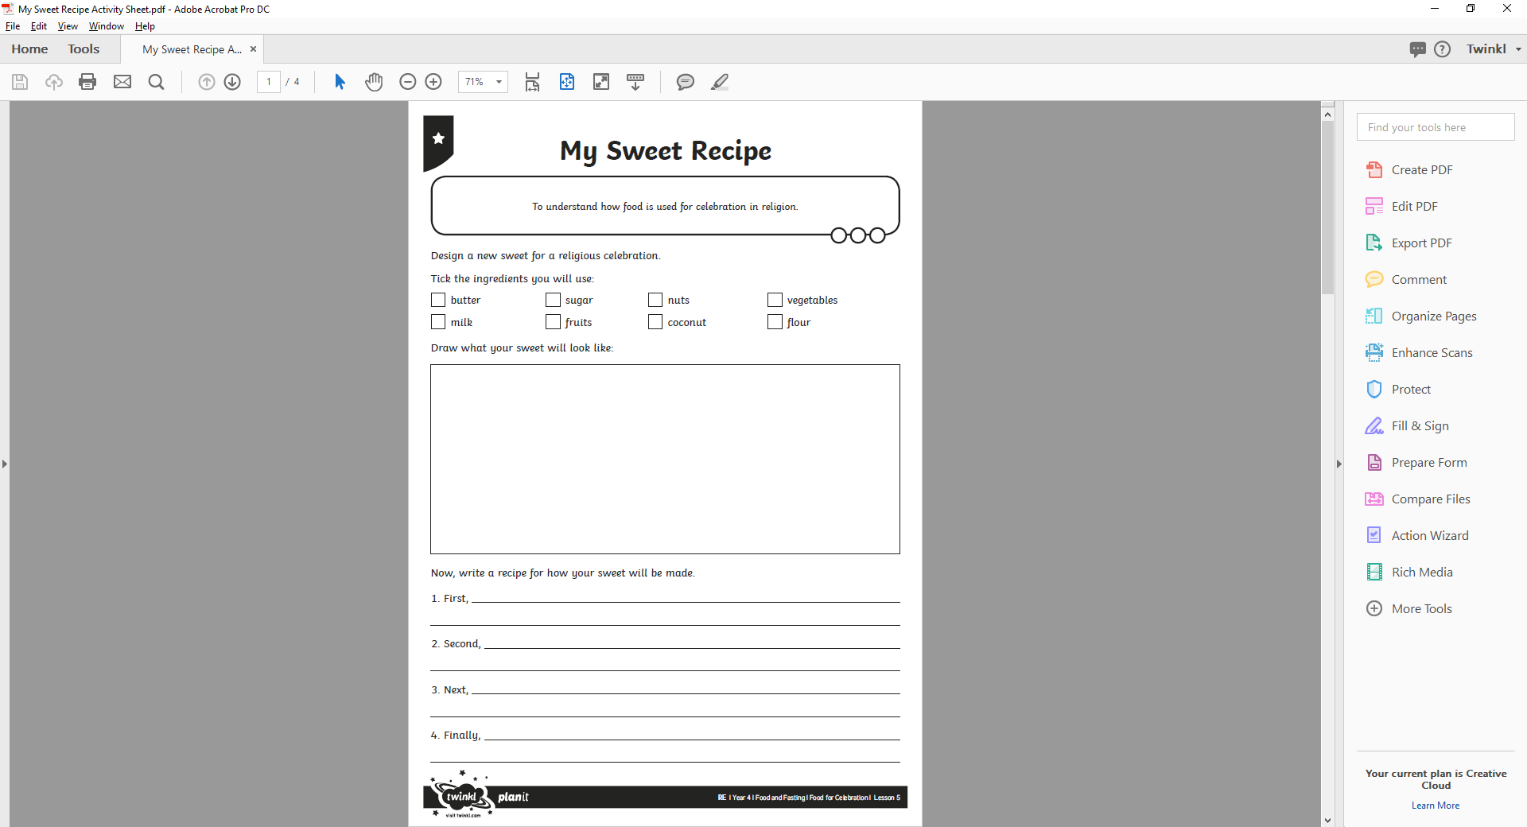
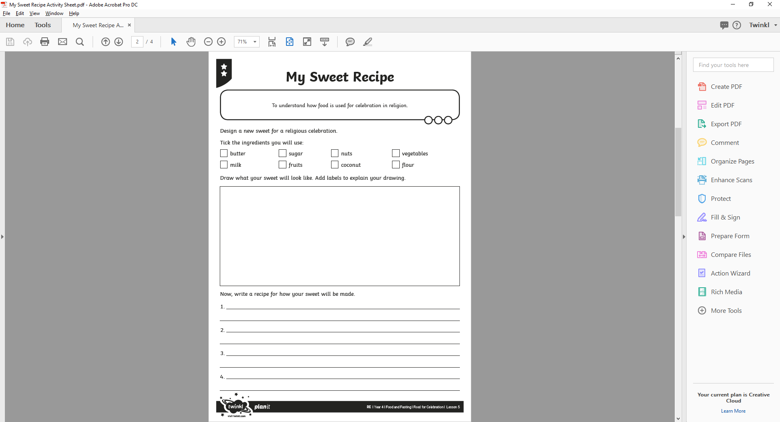
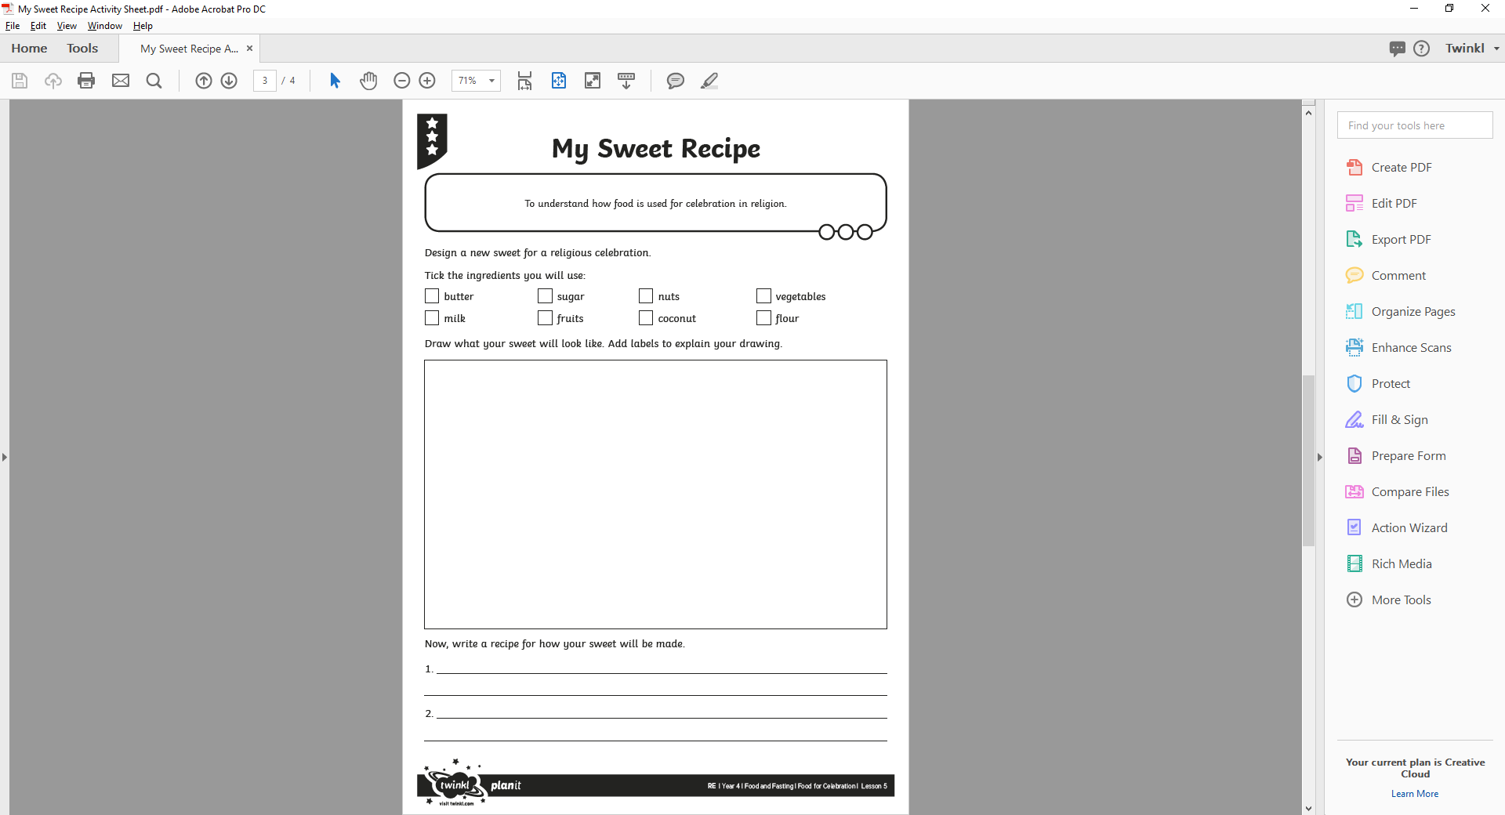
Sweet Recipe
If you were celebrating a special occasion like Diwali, what sweet food would you choose to help you celebrate?
Your task is to design a new sweet for a religious celebration. The sweet might be something that is eaten as part of a bigger feast, or could be given as a gift.
Design your new sweet and write a recipe.
What will our new sweets be like?

Slide 13
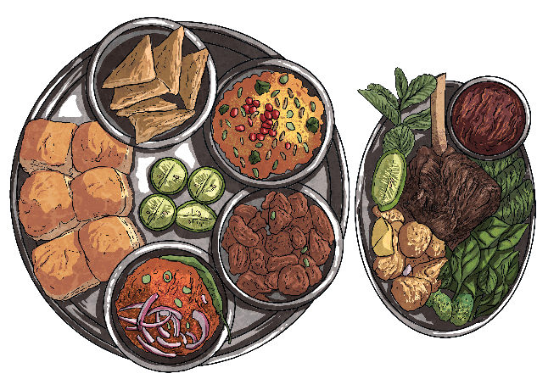
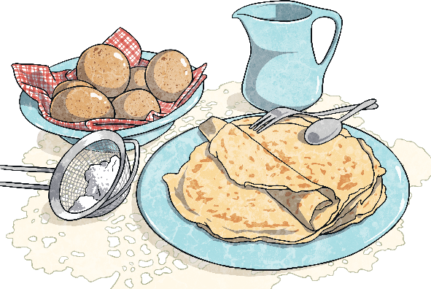
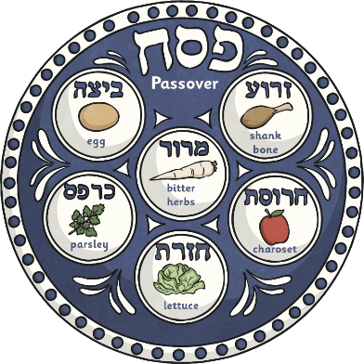
Feast!
Do you know of any other religious celebrations that include food?
A special meal is eaten during the Jewish festival of Passover.
To break the fast during Ramadan, Muslims eat iftar, a special evening meal.
Pancakes are eaten on Shrove Tuesday to use up fatty foods before Lent begins.

Slide 14
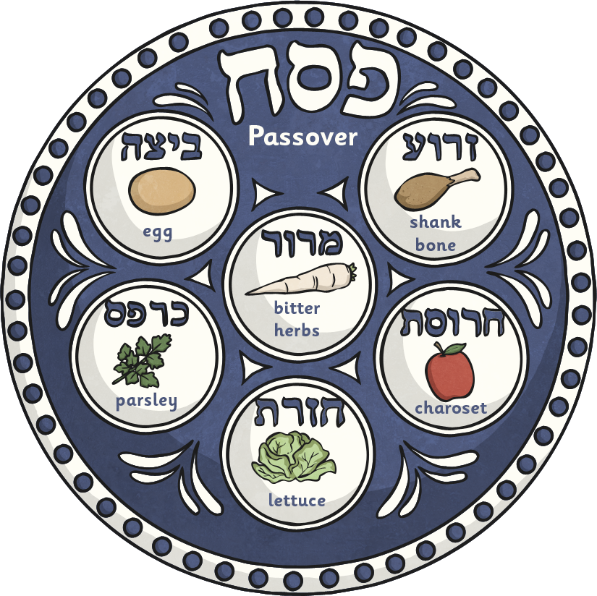
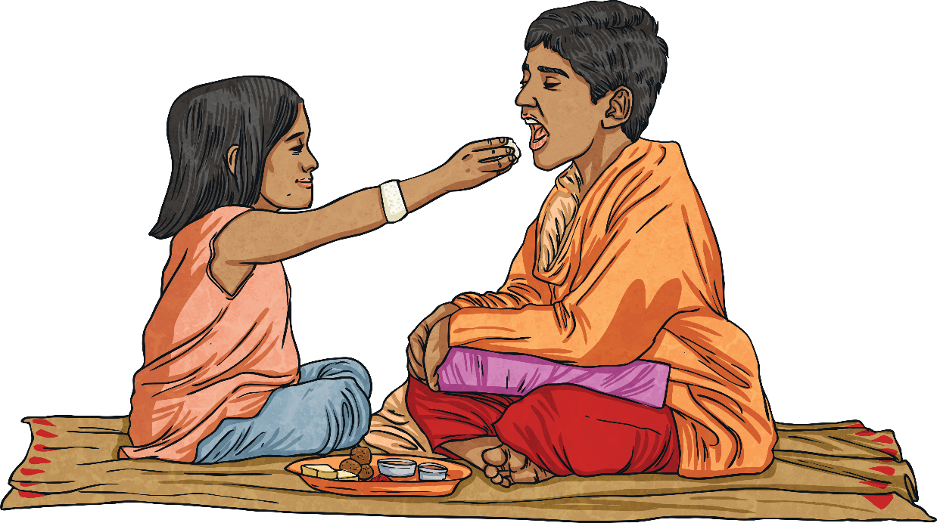
Feast!
Why do you think food is used in religious celebrations?
Other times, rarer foods, or rich or sweet foods, are used to mark how special a time is to a religion. This is like the sweets given as gifts at Diwali.
Sometimes, food is used symbolically.
The seder plate during the Jewish festival of Passover contains foods that symbolise different parts of the story of the Jewish people.

Slide 15

Aim
To understand how food is used for celebration in religion.
Success Criteria
I can share with others the foods that help me celebrate.
I can explain some key facts about Diwali.
I can name special foods for Diwali.
I can talk about the reasons why and how food is used for celebrations.
I can use key ingredients and vocabulary to create a celebratory food recipe.

